Slide 1
The Efficacy of Nonviolence in Self-determination Disputes
Kathleen Gallagher Cunningham
University of Maryland

Slide 2
Challenges over National Self-determination

Slide 3
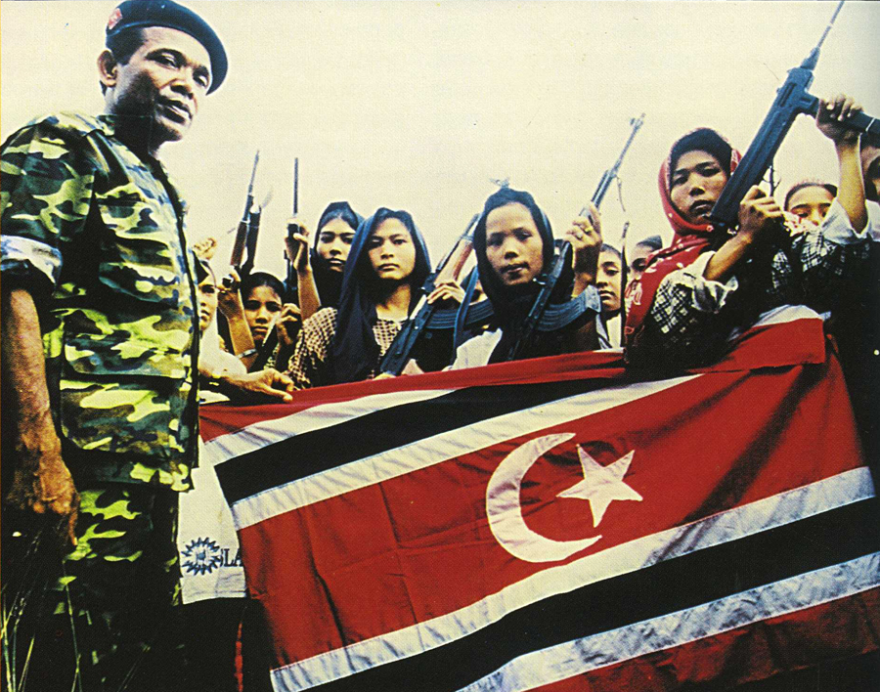
Outcomes and Processes: Violent Conflict
Free Aceh Movement

Slide 4
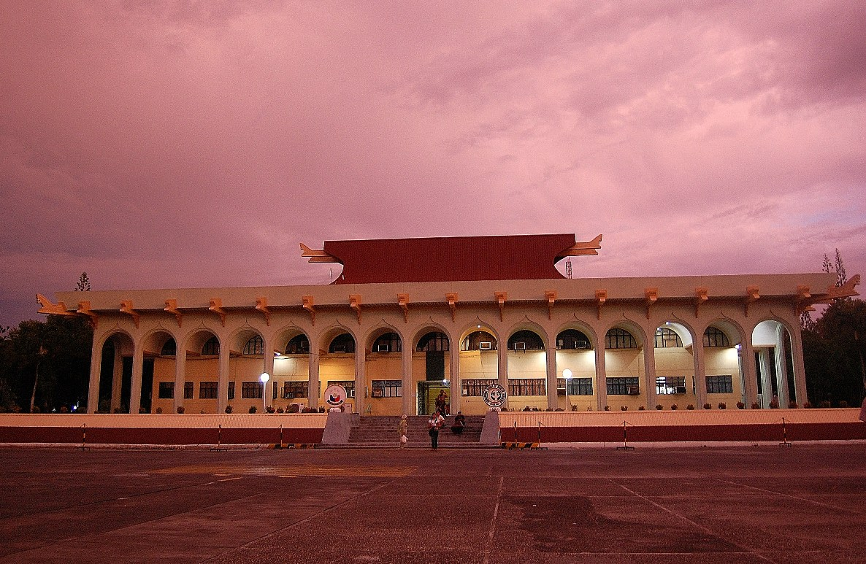
Outcomes and Processes: Accommodation
Autonomous Region in Muslim Mindanao

Slide 5
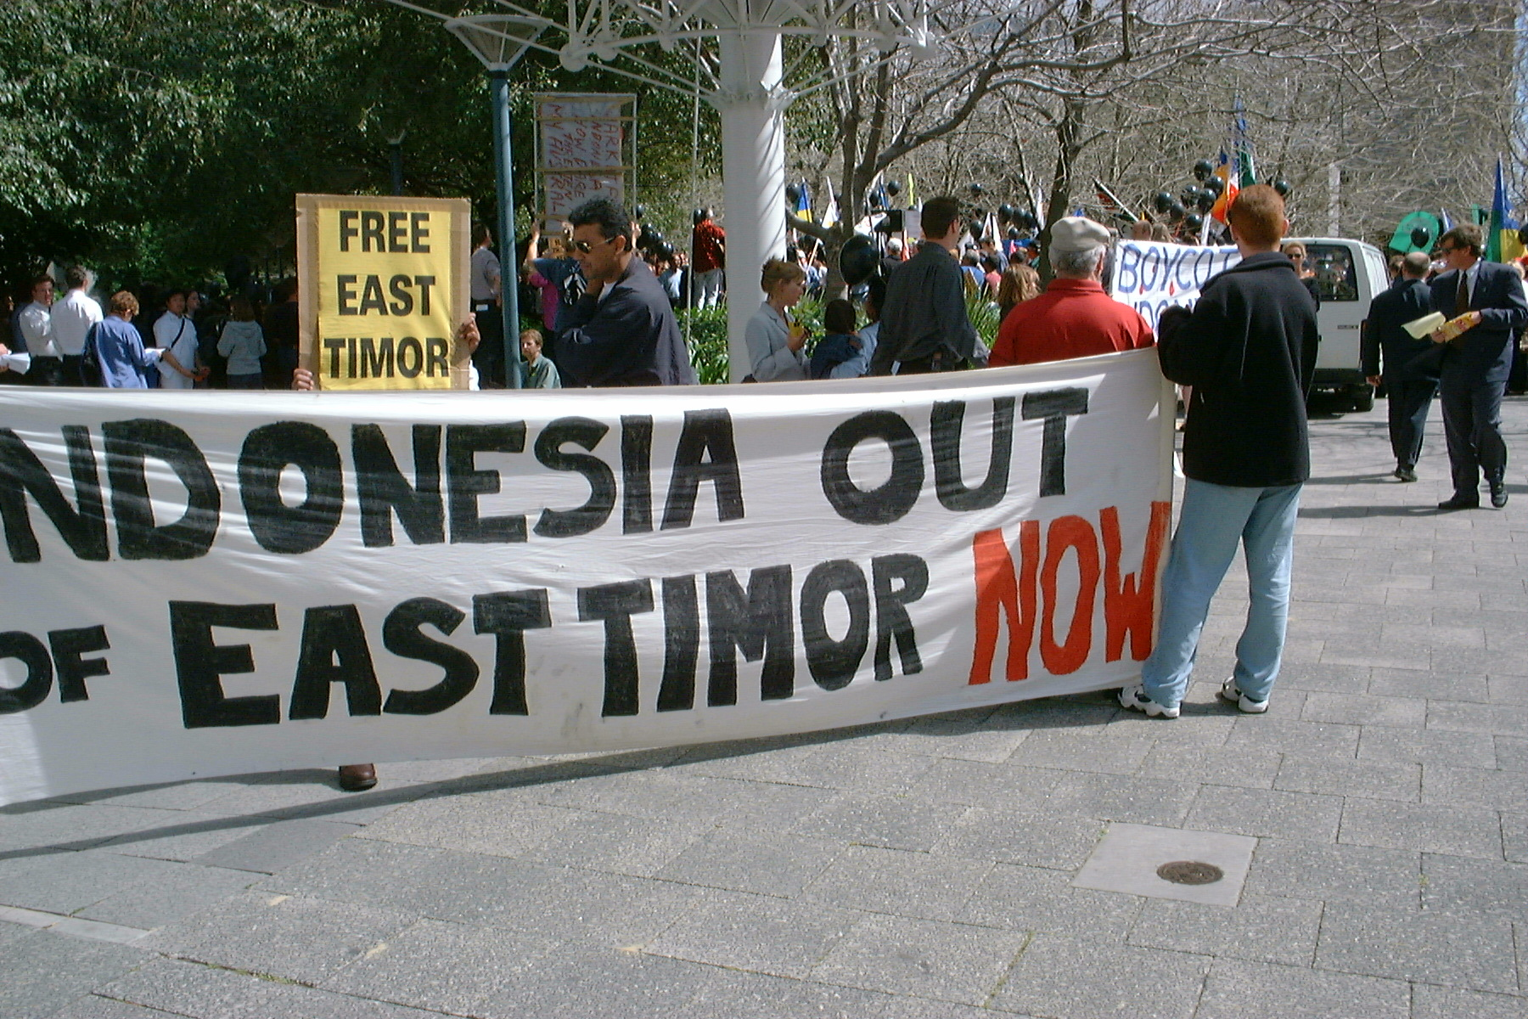
Outcomes and Processes: Mass Nonviolence
East Timor
Mass Nonviolent Campaign

Slide 6
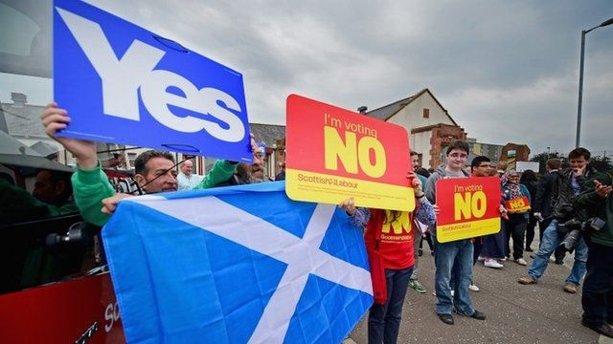
Outcomes and Processes: Nonviolent Action
Rallies in Scotland
Sit-ins in Kashmir

Slide 7
Beyond Fragmentation of Movements
139 SD movements
1960 -2005
>1200 organizations
90% internally divided

Slide 8
The role of tactics
Effects of fragmentation established
Treat organizations as similar
  IRA and Sinn Fein – two organizations
  No consideration of their diversity of strategies
Address strategy diversity at organization and movement levels

Slide 9
Movement Fragmentation and Nonviolence
Important work on nonviolence (C & S 2011)
Not used and doesn't work in separatist disputes
Not necessarily correct
Intuition → lots of nonviolent behavior

Slide 10
Data on Nonviolent Strategies
All organizations in SD movements
Use of violent and nonviolent tactics for over 12,000 organization-years
Rich variation
Organizations use
  Variety of tactics
  Switch among nonviolent
  Switch between violent and nonviolent
  Mix

Slide 11
SD Movements’ Violent & Nonviolent Behavior

Slide 12
Diversity of Organizations’ NV Strategies
Economic noncooperation: strikes, tax refusals, consumer boycotts
Protest and demonstration: rallies, protests, demonstrations
Nonviolent Intervention: sit-ins, occupations, blockades
Social noncooperation: hunger strikes, self-immolation
Political noncooperation: election boycotts, withdrawals from political office or coalition in the government

Slide 13
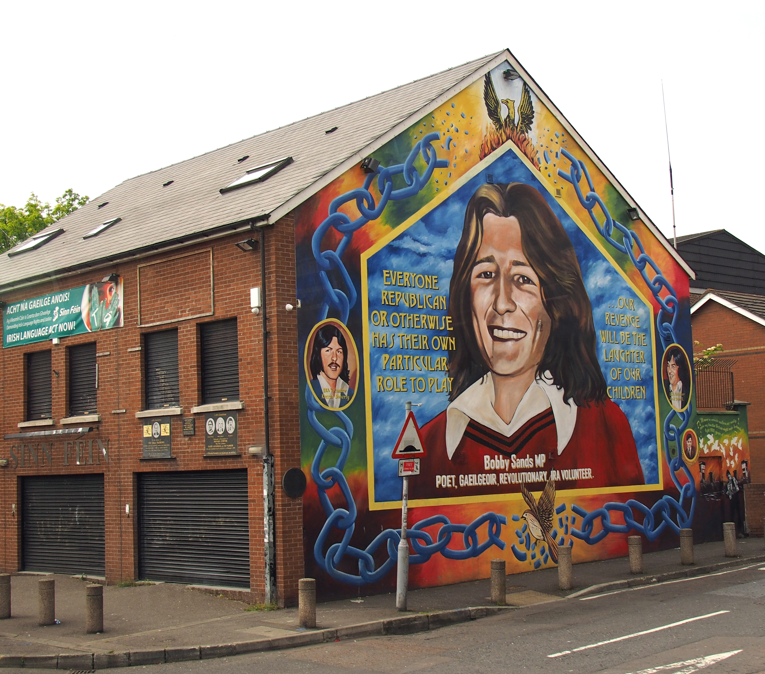
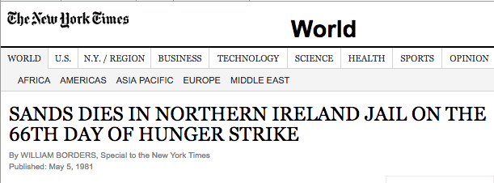
Bobby Sands & the Hunger Strike in N. Ireland
US State Department: “deeply regretted” the death of Sands
NY Governor Carey and Mayor Koch criticized British Government
Notes:
By Hajotthu at the German language Wikipedia, CC BY-SA 3.0, https://commons.wikimedia.org/w/index.php?curid=49771951

Slide 14
Understanding Efficacy
Lots of nonviolence in SD movements
Does it work?
Secession uncommon
Accommodation is not

Slide 15
Efficacy as Accommodation by the State
States accommodate to
  Manage challenges of multi-national society
  Lower costs associated with dissent
  Avoid escalation
Movements’ strategies and tactics impact this

Slide 16
Accommodation in SD Movements
Concessions over any issue related to SD claims
  Language recognition of Malay-Muslims in Thailand 1991
  Fiscal autonomy in Corsica 1974
  Mizo ”state” in India 1987
  Local administrative and fiscal autonomy for Tuaregs in Mali 1992
  Over 200 instances

Slide 17
Patterns of Accommodation
1/3 of movements get one concession
1/3 of movements get more than one concession
All regions
All regimes types
1/3 involve legislative changes
1/5 involve constitutional changes
1/5 occurred during violent conflict

Slide 18
Nonviolence and SD Accommodation
Key challenge: gaining and maintaining legitimacy
  Attract attention and support from outside
  Raise costs for state of repressing them
Nonviolence can facilitate this by:
  Shield the movement from terrorist label
  Allows framing the struggle as a human rights issue
Both make state repression more difficult & increase incentives for accommodation

Slide 19
An Alternative Path
C & S: leverage of mass NV comes from power in numbers
Through framing, NV works to constrain the state
  Makes accommodation more attractive
Mechanism: nature of nonviolent resistance & how employed to frame movement goals

Slide 20
Quantitative Empirical Evaluation
Unit of analysis: movement-state dyad year, 1960-2005
Logistic regression on accommodation
IV: Percent of organizations in movement using NV (lag)
  Alternatives: Any organization using nonviolence
Control for violence, number organizations, democracy, secessionism, economic development, time since accomm. & cubic splines
Three-fold increase in chance of accommodation [0% - 100%]

Slide 21
Predicted Probability of Accommodation

Slide 22
Strategies and Accommodation
Greater nonviolence associated with accommodation
Violence does not appear to lead to accommodation
Disaggregating nonviolent strategies:
  Any use of NV intervention associated w/ accommodation
  Among the more symbolic strategies

Slide 23
Percent vs. repertoire?
Mixed strategy
Radical flank
Diverse demands
Many movements
Ethnic exclusion
Who is doing what?
  Account for duration of organization (10 yrs or older use nv)
    Not sig predictor, but percent remains so

Slide 24
State susceptibility
Controls for which states are susceptible to external pressure:
  Small, transitional, and economically dependent
  Interacting with nonviolence: NV more effective in politically unstable states

Slide 25
Probing mechanisms & inference
Do movements using more NV get more attention/pressure?
  UN resolutions
  Use of nonviolence increases chance of a UN resolution
Non-random assignment of nonviolence
  Treatment effects models
  Movements using majority nonviolence vs. those that do not
  Higher mean predicted probability of accommodation

Slide 26
Conclusions & Future Work
Conditions for effective nonviolence in self-determination disputes
Diversity of strategies
Understanding trajectory
Other ways to think about “success”
Thank you!

Slide 27
Strategy Examples 1
Strikes: Democratic Party of Turkish Cyprus general strike 2000, CONAIE in Ecuador 1997, Jammu Kashmir Nationalist Front in India 2001
Demonstrations: Social Democratic Front (westerns in Cameroon mid-1990s), Hamas (1991)
NV intervention: Herri Batasuna (Basque) road blockade 1984, LTTE road blockade 1984, Tibetan Student Congress human chain 1996, Niger Delta People's Volunteer Force (NDPVF) shut down well in 2004.

Slide 28
Strategy Examples 2
Social noncooperation: National Alliance for Reconstruction (NAR) hunger strike (Tobagonians in Trinidad and Tobago 2002), ETA-M hunger strike 2004, Akali Dal (Sikhs in India) 1961.
Political noncooperation: Civic United Front (CUF) (Zanzibari) refuse to sit for legislative session and loose seats in 2001), Sindh Taraqi Pasand Party (Sinhis in Pakistan) boycott election in 2002.

